Slide 1
ANALOG-TO-DIGITAL CONVERSION
change an analog signal to digital data. In this section we describe two techniques, pulse code modulation and delta modulation.
Topics discussed in this section:
Pulse Code Modulation (PCM) Delta Modulation (DM)

Slide 2
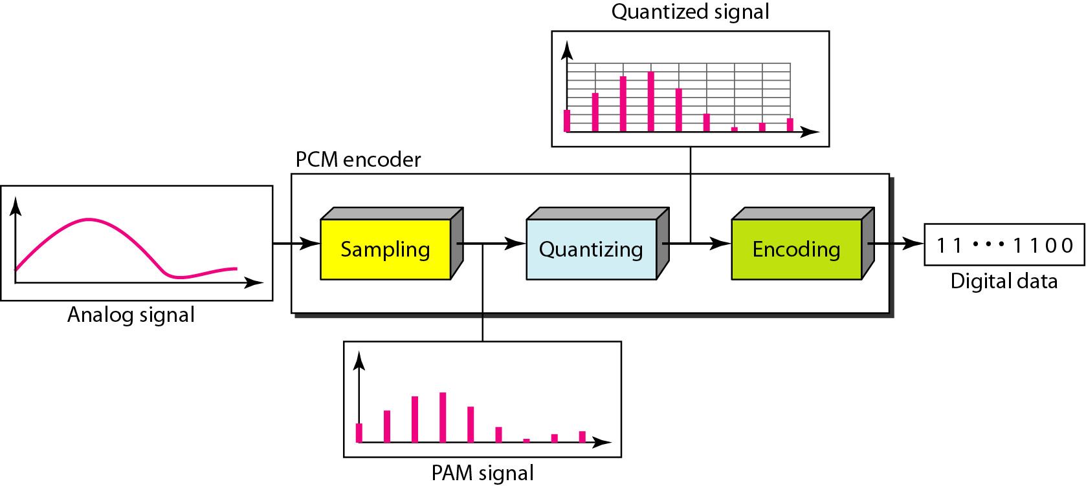
Figure 4.21 Components of PCM encoder

Slide 3
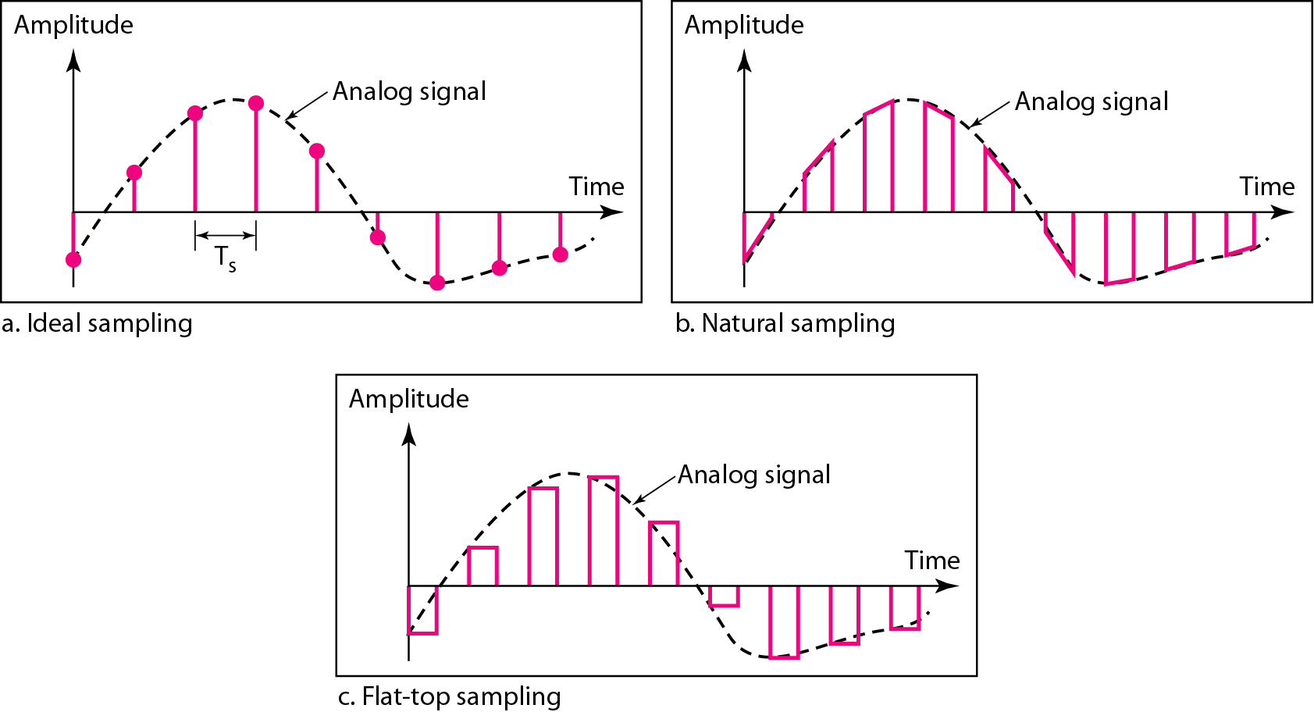
Figure 4.22 Three different sampling methods for PCM

Slide 4

Note
According to the Nyquist theorem, the sampling rate must be
at least 2 times the highest frequency contained in the signal.

Slide 6
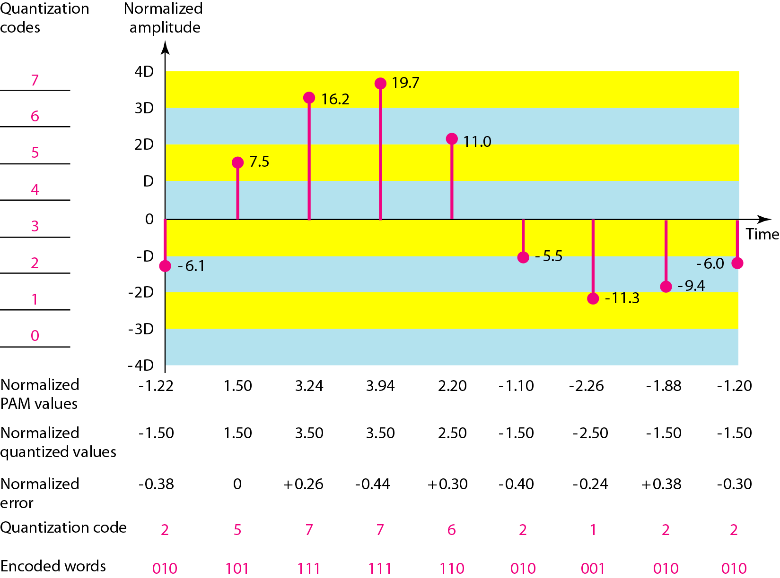
Figure 4.26 Quantization and encoding of a sampled signal

Slide 7
Example 4.14
We want to digitize the human voice. What is the bit rate, assuming 8 bits per sample?
Solution
The human voice normally contains frequencies from 0 to 4000 Hz. So the sampling rate and bit rate are calculated as follows:

Slide 8
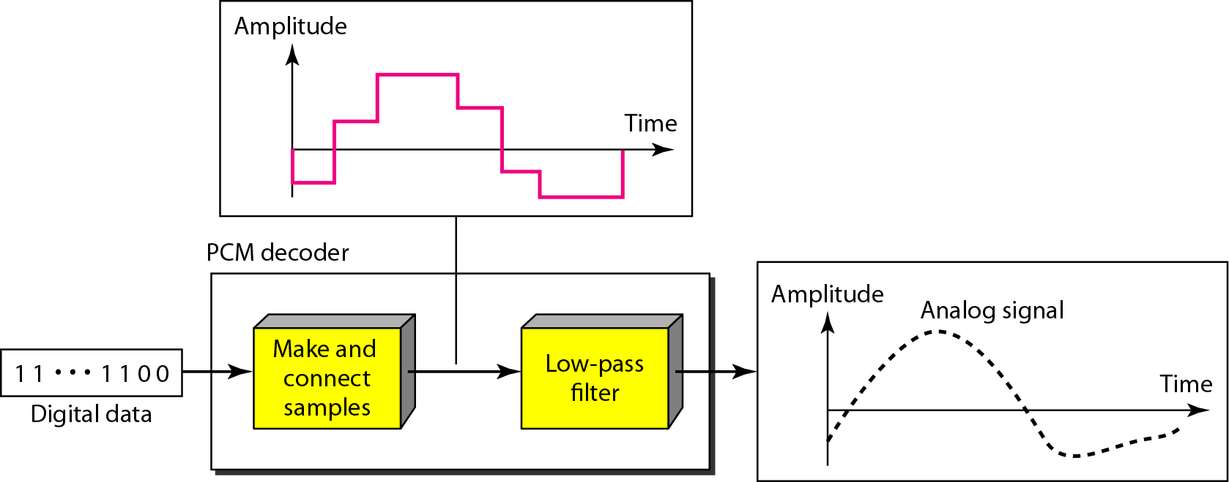
Figure 4.27 Components of a PCM decoder

Slide 9
Delta Modulation
PCM finds the value of signal amplitude for each signal.
DM finds the change from the previous sample

Slide 10
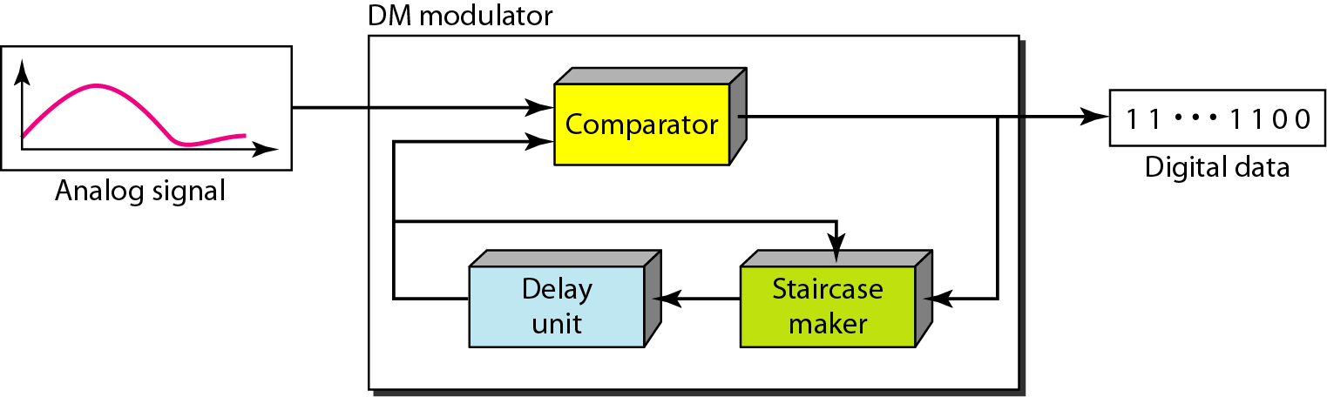
Figure 4.29 Delta modulation components

Slide 11
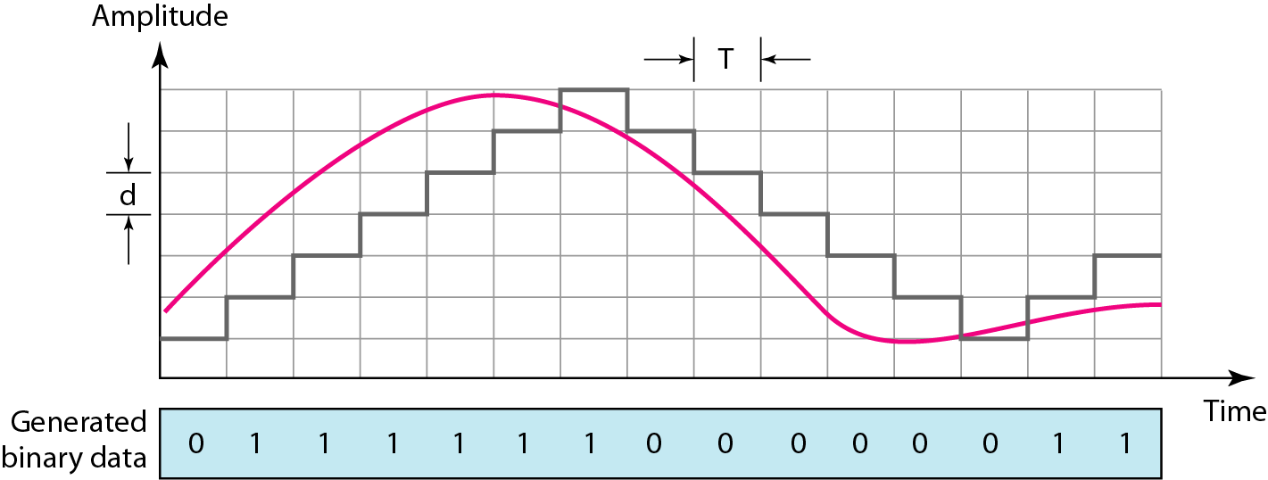
The process of delta modulation

Slide 12
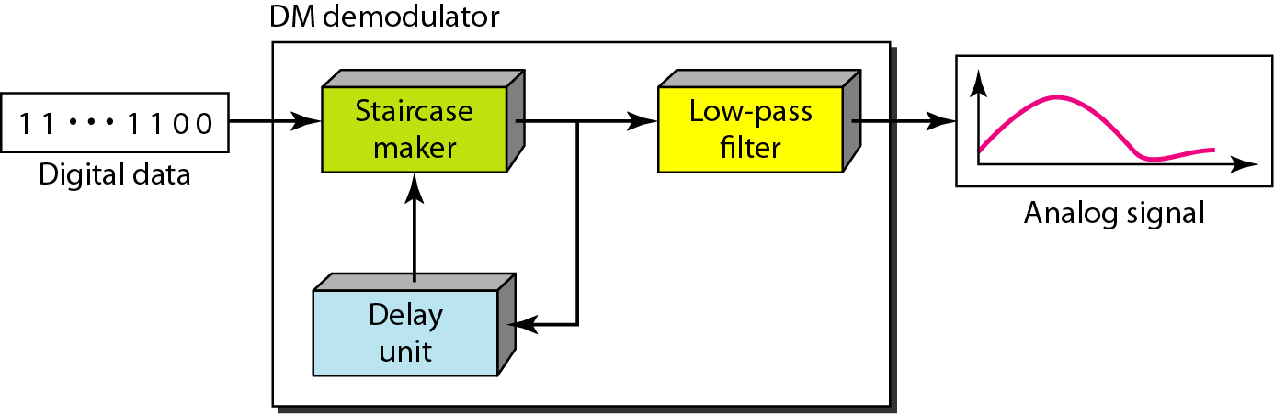
Figure 4.30 Delta demodulation components

Slide 13
4-3 TRANSMISSION MODES
The transmission of binary data across a link can be accomplished in either parallel or serial mode. In parallel mode, multiple bits are sent with each clock tick. In serial mode, 1 bit is sent with each clock tick. While there is only one way to send parallel data, there are three subclasses of serial transmission: asynchronous, synchronous, and isochronous.
Topics discussed in this section:
Parallel Transmission Serial Transmission

Slide 14
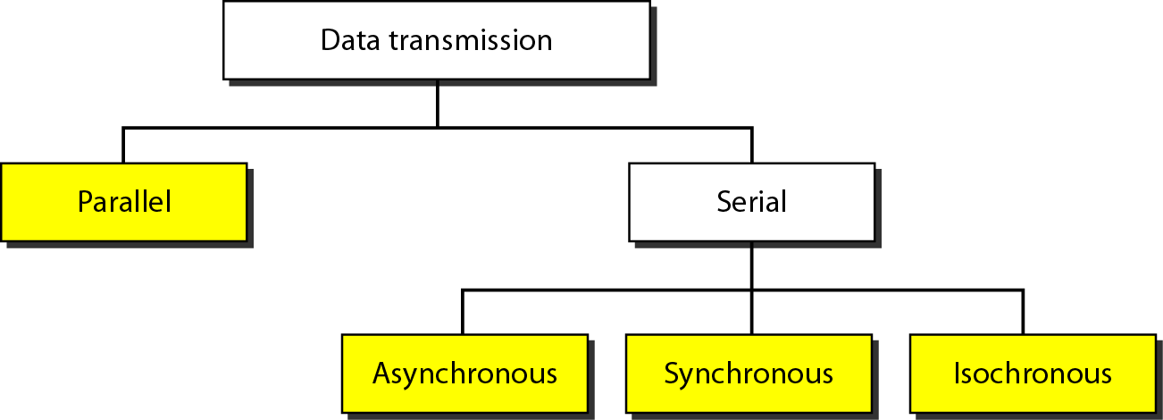
Figure 4.31 Data transmission and modes

Slide 15
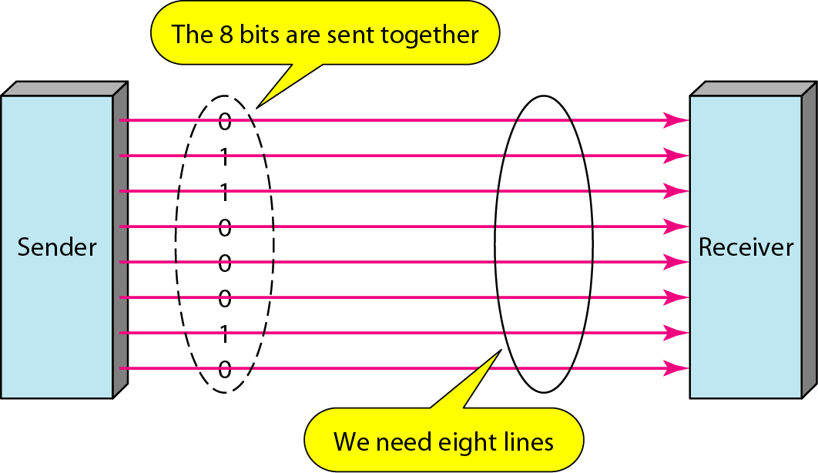
Figure 4.32 Parallel transmission

Slide 16
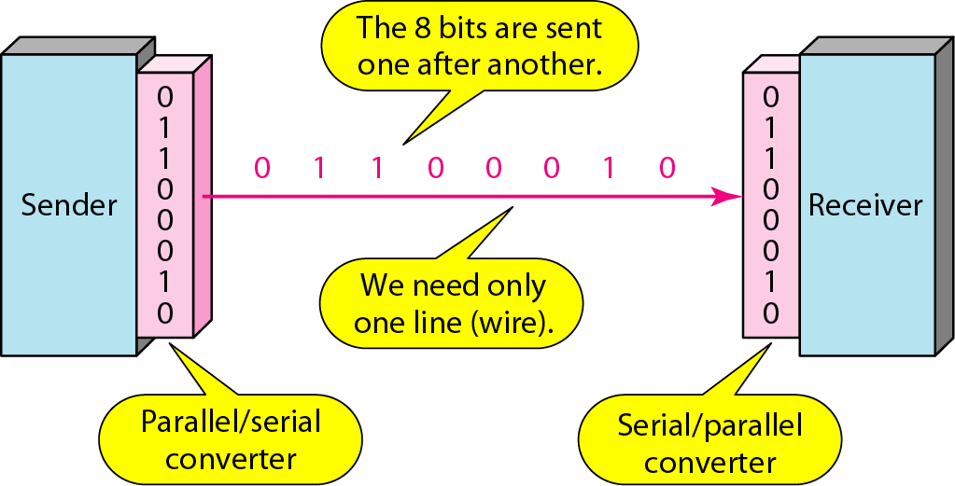
Figure 4.33 Serial transmission

Slide 17
Note
In asynchronous transmission, we send 1 start bit (0) at the beginning and 1 or more stop bits (1s) at the end of each byte. There may be a gap between each byte.

Slide 18
Note
Asynchronous here means “asynchronous at the byte level,”
but the bits are still synchronized; their durations are the same.

Slide 19
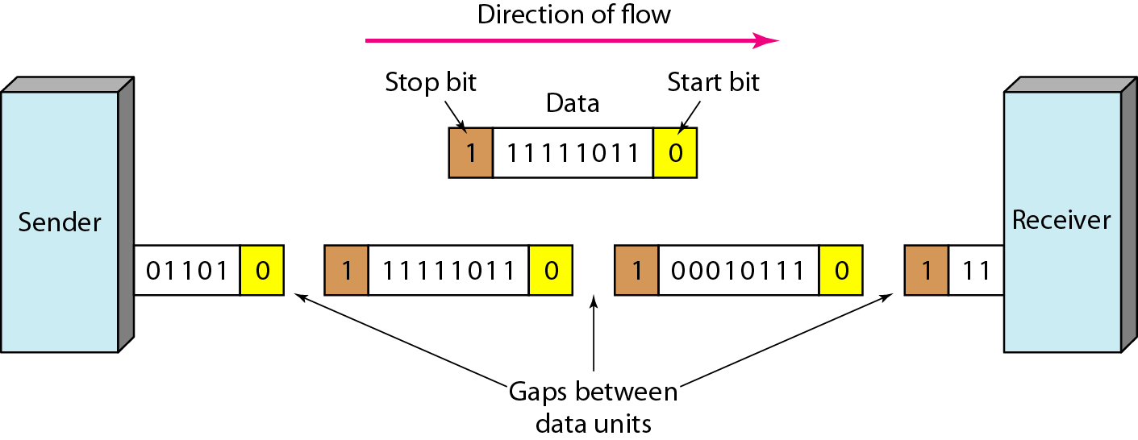
Figure 4.34 Asynchronous transmission

Slide 20
Note
In synchronous transmission, we send bits one after another without start or stop bits or gaps. It is the responsibility of the receiver to group the bits.

Slide 21
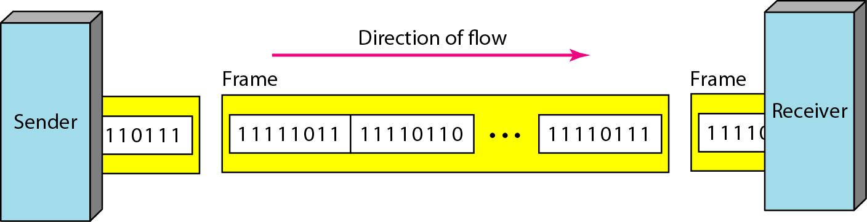
Figure 4.35 Synchronous transmission

Slide 22

Chapter 4
Digital Transmission
Copyright © The McGraw-Hill Companies, Inc. Permission required for reproduction or display.

